Slide 1
Product Lifecycle (PLC) guide
T+IL Playbook
See file name for date and time of last update (e.g., 20190601 Product team operating model – T+IL playbook – v1230)

Slide 2
Playbook context – product team operating model
This chapter
Chapter
Description
File name
T+IL in a nutshell
An overview of the Lab’s scope, guiding principles, and purpose
[Date] T+IL nutshell - T+IL playbook - v[Time]
Lab operations
A high-level view of the Lab’s structure, governance, and operating model
[Date] Lab operations - T+IL playbook - v[Time]
Product Lifecycle guide
Walkthrough of the Lab’s Product Lifecycle (PLC) governance, with detailed guidance for each review
[Date] PLC guidebook - T+IL playbook – v[Time]
Product team operating model
Overview of how product teams operate, including structure and ceremonies
[Date] Product team operating model - T+IL playbook – v[Time]
T+IL talent guide
An overview of all things talent for the Lab, including recruiting, capability-building, and performance management
[Date] T+IL talent guide - T+IL playbook - v[Time]
Onboarding playbook
A guide for people joining the Lab
[Date] Onboarding playbook - T+IL playbook - v[Time]

Slide 3
Contents
Overview of the PLC process
Deep-dive on PLC stages and PLC Reviews
Tactical guidance for PLC Reviews

Slide 4
Product Lifecycle Reviews (PLC Reviews) govern a product’s path from an idea to a scaled product
Current T+IL scope
Product lifecycle
PLC Reviews
1
PLC Review
2
PLC Review
3
PLC Review
4
PLC Review
PLC phases
Ideate
Pre-discovery
Discovery
MVP build
Scale
Sustain
Retire
Outputs
Prioritized ideas
Simple business case for funding
MVP with high-level architecture, refined business case, and KPIs
MVP in the field
Product with substantially complete features
Updates and support to products in the field
End of product in the field

Slide 5



New product ideas will have to go through the Lab’s intake process, including two key decision points with Lab leadership
Key decision point
Process
Intake process (subset of Product lifecycle)¹
Idea Review
Ensure product efforts are (a) tied to user / business impact, (b) conducive to agile, and (c) tactically ready to launch
Align exec vision with PO
Balance resources required with other portfolio commitments
1
1
PLC Review
2
PLC Review
Ideate²
Pre-Discovery
Discovery
Sprint 0
Stake- holders:
Idea Owner
LP IRD or local R&D
TIS BPs
Idea Owner
Relevant SMEs
Central Finance Rep
TIS BPs
Product Owner³
Scrum Master as needed⁴
Solutions Architect
Designer(s) as needed
SMEs as needed
Product Owner
Agile Team
Commit to MVP
Approve MVP design
Define aspirational impact with detailed KPIs to track
Ensure that product design and build aspirations will deliver on aligned impact
Balance resources required with other portfolio commitments
2
Lab Support:
N/A
Central finance support building business case (optional)
Workshop support (e.g., Zero-Based Design Development, MVP workshop)
Guidance and feedback on validation
Access to full Lab resources and support
Tasks:
Create initial idea with product path characterization
Build product concept designs (drawings, photos, description of use)
Build business case for product path
Design go-forward plan for discovery
Conduct high-level technical impact assessment
Discovery Kickoff
Mapping Current State
Zero-Based Design Development
Minimum Viable Product (MVP) Workshop
Define priority features for MVP
High-level MVP architecture
Validation
User testing
Business case refinement (including resource requirements)
KPIs with targets
Detailed technical impact assessment
Conduct major pre-sprint activities, e.g., mobilizing teams, setting up workstations and access, confirming space
Develop backlog
Conduct team kick-off
The PLC Review 1 and PLC Review 2 act as separate stage gate steps of the intake process, however they will be conducted at the same monthly meeting
1 Product refers to digital products and/or software, not just widgets
2 Please see appendix for delineation between LP and non-LP products during the ideate phase
3 PO during Discovery may not remain as PO after PLC Review 2
4 Scrum Master role is dependent on team needs. Role may be shared across multiple agile teams

Slide 6
As products mature, they will undertake further reviews to determine whether further build-out of the product is valuable
Key decision point
Process
MVP Validation and decision to Scale
Review MVP output and value tracking
Approve next feature set for deployment and the shift to Scale
Approve KPIs for first Scale deployment
Highlight preliminary risks and present go-forward mitigation plan
Align on Lab logistics
Team structure
Deployment time box
Relevant SME’s
3
3
PLC Review
4
PLC Review
MVP
Scale
Sustain
Retire
Stake- holders:
Product Owner
Agile team
SMEs as needed
Product Owner
Agile team
SMEs as needed
Value Advisor
Product Owner
Sustainment team
Product Owner
Sustainment team
Lab Core Foundations team
Lab Support:
Full Lab resource & support
Full Lab resources & support
Minimal support unless needs are advanced (e.g., ML adjustments)
Core Foundations team
Tasks:
MVP development
Working prototype
Identified sources of value
Business case & relevant value drivers for further features
Feature set for further deployments
Completion of Scale phase with required features deployed and scaled to organization
Demonstration of working product
Summary of potential features that could be built out and estimated business impact of further development
Update and support products in the field
Identify tools and assets to be pulled into tool repositories for future products
Decommission product from the tech stack
Deployment review and evaluation of remaining value
Review deployment feature set and validate value tracking
Determine value in next deployment and determine whether to shift to Sustain as a result
Determine where Sustain should be owned (TIS versus Lab)
Identify support structure / team needed and go-forward read-out cadence to LET
4

Slide 7
Contents
Overview of the PLC process
Deep-dive on PLC stages and PLC Reviews
Ideate, Pre-Discovery, and PLC Review 1
Discovery and PLC Review 2
Sprint 0, MVP Build, and PLC Review 3
Scale and PLC Review 4
Tactical guidance for PLC Reviews

Slide 8
Contents
Overview of the PLC process
Deep-dive on PLC stages and PLC Reviews
Ideate, Pre-Discovery, and PLC Review 1
Discovery and PLC Review 2
Sprint 0, MVP Build, and PLC Review 3
Scale and PLC Review 4
Tactical guidance for PLC Reviews

Slide 9
Ideas come to the Lab from the business, with the help of TIS BPs and BRMs
Ideate
Pre-Discovery
Idea owner starts creating artifacts for Ideate and seeks business sponsor.
BRM supports Idea owner through ideate (and envisioning, where applicable)
BRM reviews artifacts and shifts idea to Pre-Discovery if appropriate
Idea Owner and BRM work together to produce Pre-Discovery artifacts ahead of PLC Review 1
Idea development
Business stakeholder has an idea, or ideas get generated in the course of innovation initiatives in the business (e.g., Excellerate)
If not clear, an idea owner gets chosen by the business, who then shares idea with corresponding TIS BRM
Lab leadership informed and review to ensure fit for Lab (alignment with Product Paths, etc.)
Lab coordination
Lab leadership puts idea on the schedule for next LET discussion for a PLC Review 1 (if appropriate, based on triage)

Slide 10


Ideas coming to the Lab will be consolidated into product paths before evaluation in PLC Review 1
Create new product path, run Pre-Discovery, and add to product path list
Owner
Activity
No
Stakeholder
Decision point in process
Idea owner/ TIS BP
Revise prioritization of product paths as part of PLC 1 in PLC Review meetings
Other TIS BPs to validate the need of new product paths
Assess impact and Tech dependencies of new business idea and identify right product path
Product path already exists?
Technology head to help identify Tech dependencies
Lab Executive Team
Idea owner/ TIS BP
Product owners to help identify product paths
Yes
No
Revise impact metrics and run Pre-Discovery if needed
Is there a product team aligned?
Technology head to help identify Tech dependencies
Idea owner/ TIS BP
Technology head to help identify Tech dependencies
Yes
Add initiative to product backlog
Idea owner/ Product owner

Slide 11
Through these intake processes, Idea Owners will have to generate artifacts to bring the idea and its value to life
CHECKLIST
Ideate
Pre-Discovery
Idea
High-level business case
Go-forward plan for Discovery
Idea concept (can be a description of idea, how it works, and any important callouts)
Initial business case with
High-level investment required
ROI
Timeline
Risks and dependencies
Suggested impact
Proposed Product Owner (if not Idea Owner)
Discovery workplan (e.g., Discovery Kickoff, Zero-Based Design, MVP)
Visual mockups, sketches, or prototypes of idea
Business sponsor
List of required resources (people + equipment) to begin Discovery
High-level technology impact assessment
TIS will partner with business-side Idea Owners to support ideas through Ideate and Pre-Discovery
LP IRD will own Ideate and parts of Pre-Discovery for LP-related product ideas

Slide 12
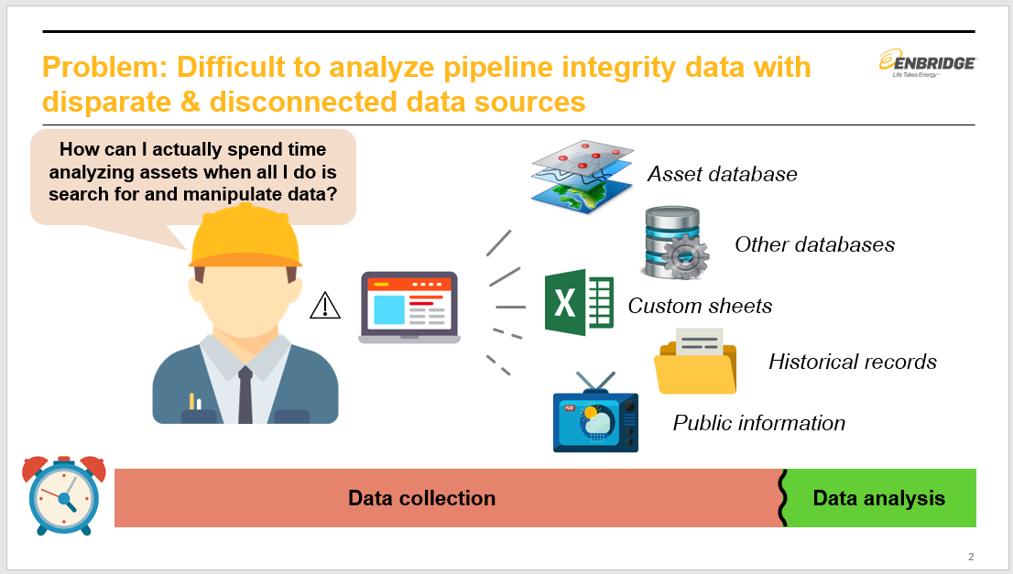
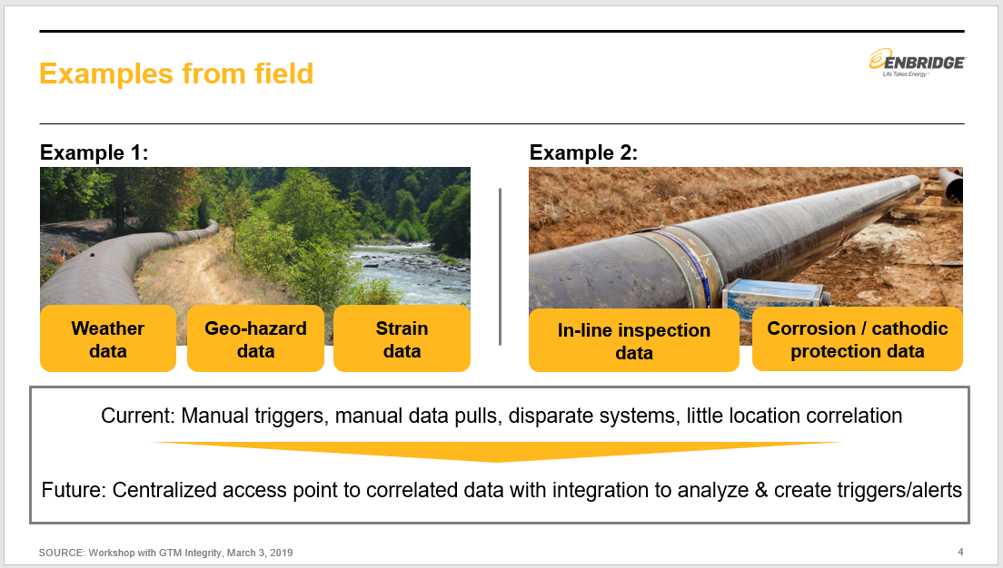
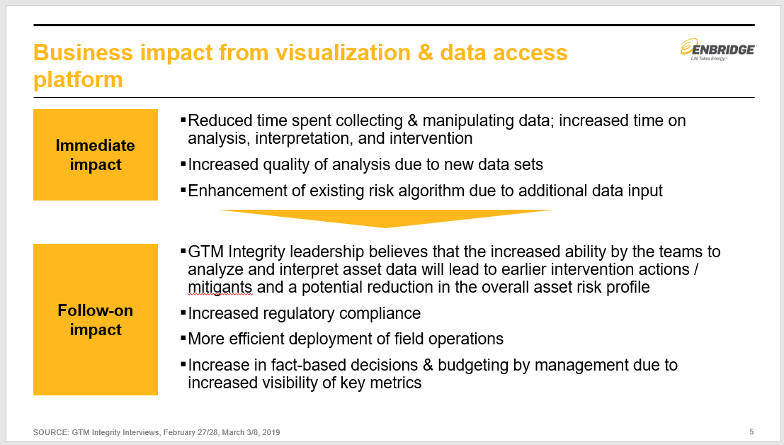
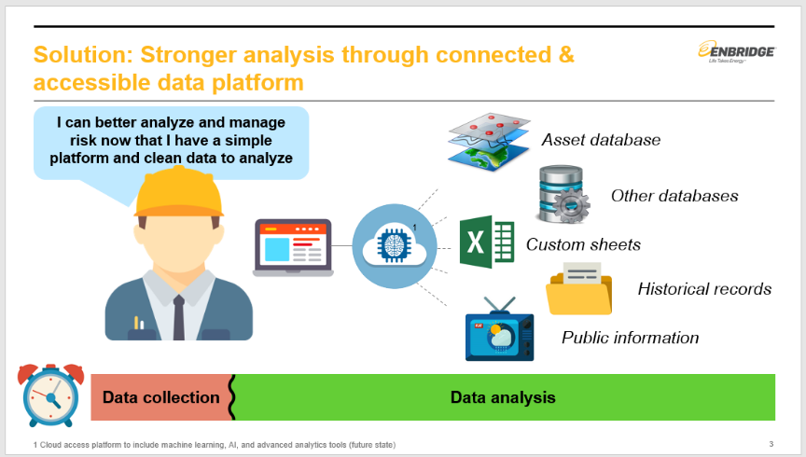
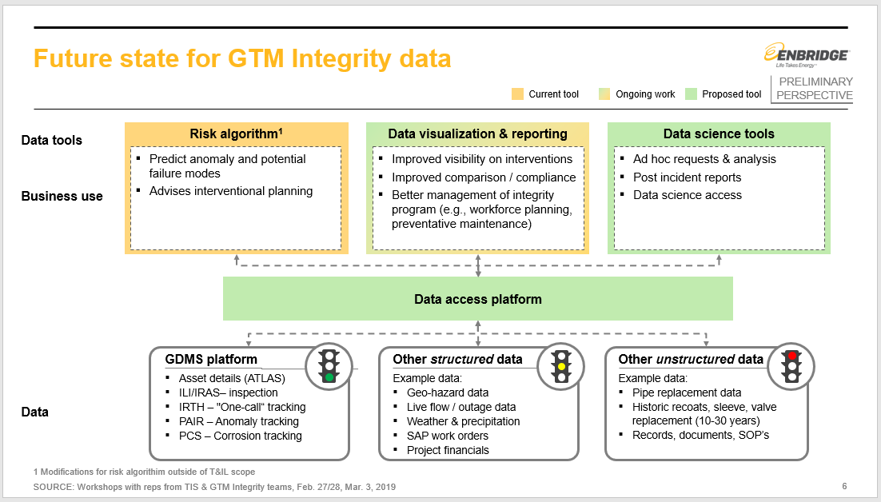
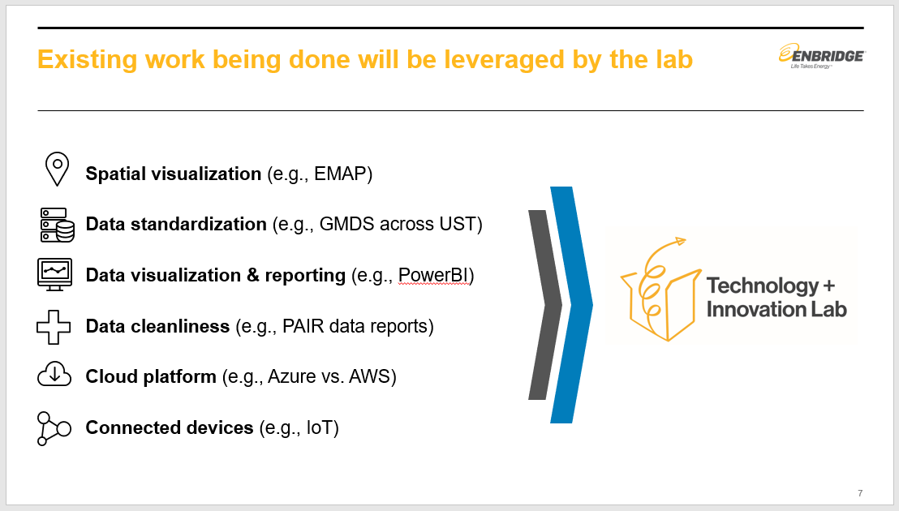
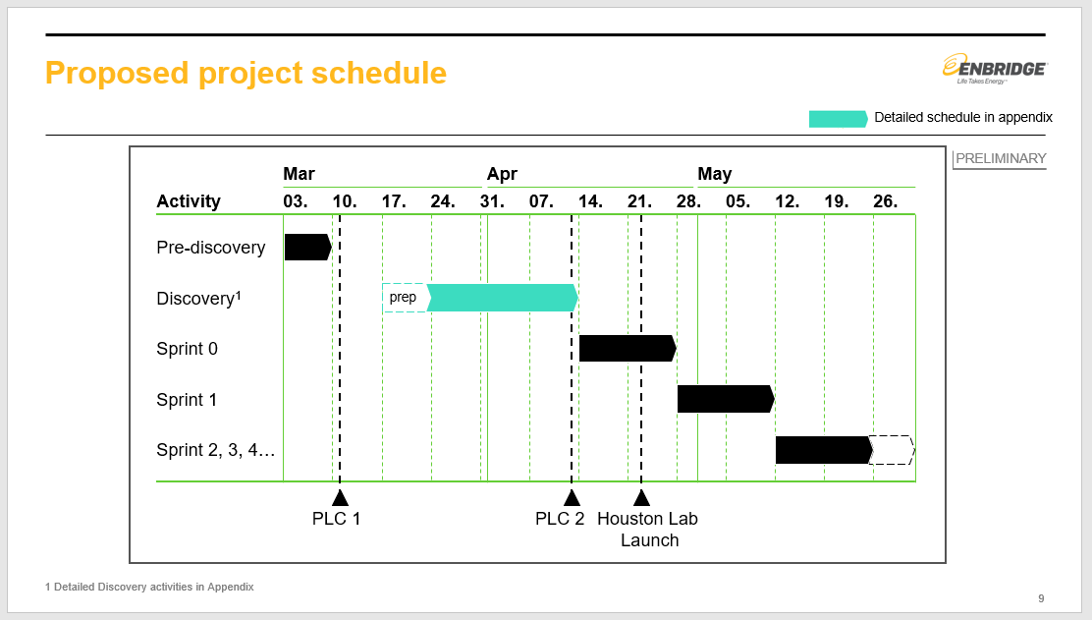
Pre-Discovery generates artifacts to capture ideas within a product path and shape go-forward approach
Business problem / proposed solution
Examples from the field
Business impact
Semi-detailed solution / structure
Existing work
Plan for Discovery phase
SOURCE: GTM Integrity PLC1 Review, March 2019

Slide 13





After Pre-Discovery, PLC Review 1 determines if an idea has the value and feasibility to move on to Discovery
PLC Review 1 Process
Example Agenda:
Overview of product idea – (10 min)
Business case presentation – (10 min)
Q&A (5 min)
Business case approval and PO assignment (5 min)
Purpose
Stakeholders
Pre-work
Tasks
Go / no-go criteria
1
PLC Review
Determine if the idea is feasible and impactful enough to move forward
Provide executive guidance and steering on idea
Idea Owner – responsible for presenting the idea
Lab Executive Team – responsible for approving the business case and qualifying criteria for go / no-go have been met
Idea concept / visual mockup with business sponsor
High-level business case (with high-level tech impact assessment)
Go-forward plan for Discovery phase
Proposed PO
Discovery workplan
List of required resources (stakeholders, space, etc.)
Approval of business case and necessary go / no-go criteria
Assignment of product owner and other key resources to team
Funding secured to proceed with Discovery
Business sponsorship and support plan
Significant business impact with trackable KPIs
Aligned to agile principles
Aligned to Lab digital strategy and existing product pathways
30 min¹
If a product idea does not successfully pass through the first PLC Review, it may:
Be sent to do further Pre-Discovery work before a second attempt
Be paused for a period of time until sufficient supporting work is done (e.g., data collection)
Be asked to combine with another idea to create a combined product idea
1 Per product

Slide 14
Contents
Overview of the PLC process
Deep-dive on PLC stages and PLC Reviews
Ideate, Pre-Discovery, and PLC Review 1
Discovery and PLC Review 2
Sprint 0, MVP Build, and PLC Review 3
Scale and PLC Review 4
Tactical guidance for PLC Reviews

Slide 15
After approval at PLC Review 1, an idea shifts into the Discovery phase for further evolution
Sprint 0
Deep dive to follow
Product lifecycle
Ideate
Pre-discovery
Discovery
MVP build
Scale
Sustain
Retire
Discovery is the phase at which the key players on the product team take the original idea and turn it into a product vision to meet user needs and drive business impact

Slide 16
Discovery is a 10+ day process that transforms the product idea into a validated MVP design
Intake process (subset of Product lifecycle)¹
1
PLC Review
2
PLC Review
Ideate²
Pre-Discovery
Discovery
Sprint 0
Discovery Kickoff
Mapping Current State
ZBD Development
MVP Workshop
Validation
Day 1
~Day 10
Intros, clarification of roles and responsibilities, review of agile methodologies
Map the current process to understand critical components and pain points
Create user personas to inspire ideal journeys (based on user research data)
Understand current technical landscape in potential product space
Define and map ideal user journey based on user research, design thinking, and desired outcomes
Translate user journey into zero-based product design
Refine design to focus on only critical features based on user needs to deliver rapid value (Minimum Viable Product, or MVP)
Map high-level architecture for MVP
Test and refine MVP for impact and feasibility
User testing for MVP design
Refined business case for MVP
Key MVP KPIs with targets
Detailed technical impact assessment
Select agile processes are used throughout Discovery (e.g. end of week check-ins, stand-ups)

Slide 17
Example overview of Discovery activities
Key workshops
EXAMPLE
Day 1
Day 2
Day 3
Day 4
Day 5
Week 1
Discovery Kickoff
Mapping Current State
Review
Introductions, roles and responsibilities
Review Discovery process
Vision and Definition of Success
Universe mapping
Rituals and cadence
Team norms
Understand the user
Identify users
Empathy Maps
Persona definition and prioritization
Synthesize findings
Identify research spikes related to the user
Context
Review Industry trends (Hard and Soft)
Define current journey
Identify pain points
Technology and data assessment
Identify business drivers and KPIs
Synthesize findings
Create Problem Statement:
Review previous day
Define Problem statements
List of initial Technical Knowns, Unknowns, Risks, and Questions to answer
Define target KPIs
Synthesize findings for demo
Demo
Personas
User Learnings
User Journey
Current Architecture and IT capabilities
Problem statement
Planning for second week
Week 2
Day 6
Day 7
Day 8
Day 9
Day 10
ZBD Development
MVP Workshop
Validation
Review
North Star
Define a North Star
Articulate new user journey
Identify signature moments
Begin building a high-level business case
Begin future architecture design
Prototype builds
Sketch ideas
Low fidelity prototype of selected ideas
User validation
Begin adding rough stories to Backlog based on prototype requirements
Initial MVP Definition
Review and prioritize list of features from prototypes
Prioritize features
Map to journey
Raise or accept known risks
Complete future architecture design
Prioritize MVP features
Roadmap
Define (MVP feature set and subsequent stages)
User testing
Define team capabilities required for MVP
Pressure test business case
Detailed technical impact assessment
Demo
Future Journey
MVP Journey
Prototypes
Roadmap based on current MVP feature set
Lightweight business case
Future architecture design
Additional detailed definition of the MVP scope will continue into the following weeks as needed, with the entire Discovery process running anywhere from 1-4 weeks

Slide 18
The Discovery phase results in a validated MVP in the form of a detailed business case and detailed tech impact assessment
Overview of validated MVP design
Detailed business case
Detailed technical impact assessment
Product scope
Operational information
Technical assessment requirements
Product path description
Delineated scope
MVP features
Potential post-MVP features
Targeted user groups
Business sponsor
Go / no-go recommendation
Resource needs (e.g., people, licenses, hardware)
Implementation strategy
MVP Delivery Plan
Sequencing and dependencies
Technology stack requirements defined (e.g., architectural vision) highlighting any needed changes
Data source identification
Technical risks identified
High-level data quality assessment
Impact
Investment required
Business impact with analysis summary
Key KPIs
Impact targets against KPIs
Estimated costs for MVP development
Estimated level of effort (story points) for MVP development
Estimated time to impact

Slide 19
A Discovery Kick-off should be conducted to onboard the entire team and key stakeholders
Objectives of the Discovery Kick-off meeting
Key topics
Provide an introduction to the Tech + Innovation Lab
Introduce Agile principles and ways of working
Establish scope of Discovery phase
Discuss next steps
Introduction to the Technology + Innovation Lab
Overview of the Lab methodology
Team roles and responsibilities (if team already selected)
Overview of product idea
Plan for Discovery phase
Attendees
Product Owner
Solutions Architect
Designer(s) as needed
SMEs as needed
Scrum Master as needed
Discovery Kickoff
Mapping Current State
ZBD Development
MVP Workshop
Validation

Slide 20

Defining the current state helps clarify user pain points and areas for opportunity
2
Zero-Based Design
Build the ideal journey state from the user’s perspective
Identify the design features that enable this journey
1
Current state
Understand the existing user process and its “pain points”
Understand current technology and data landscape
3
Minimum Viable Product
Establish the MVP by:
Test zero-based state (e.g. ZBD output) in real-world and understand technical and implementation barriers and constraints
Identifying what is realistically achievable during sprinting
End-up with only what is absolutely necessary to deliver the stated outcome
Discovery Kickoff
Mapping Current State
ZBD Development
MVP Workshop
Validation

Slide 21
Multiple avenues are used to develop a complete picture on the current state
User Interviews
The core of the Discovery phase, often yielding the most input on what your user values the most
User Personas
Behavioural and psychographic profiles of target users representing distinct needs, values, pains, and motivations throughout the user lifecycle
Empathy Maps
Artefact used to understand a user’s motivation for a particular solution to tasks.
Allow you to consider and examine your target user’s greatest motivations, desires and hurdles when it comes to your business or product
User Journey Maps
Used to narrate the persona(s) interaction in the current state
Help understand user pain points and current frustrations
Discovery Kickoff
Mapping Current State
ZBD Development
MVP Workshop
Validation

Slide 22
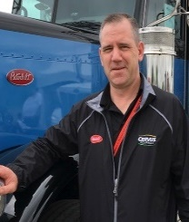

Structured user interviews are a key source of insights on what your users value most
User Interviews
User-centered design is all about talking with people about their challenges, goals and constraints
Interviews are the core of the inspiratory phase. It is important to hear their needs in their own words
How to do them
Conduct interview in the environment, or context, in which the experience occurs (e.g. putting in a change order, updating the schedule or performing a quality control).
Results are usually qualitative, observed data, rather than quantitative, measured data and give a more holistic understanding of the design and construction processes than is possible via traditional interviewing techniques
Discovery Kickoff
Mapping Current State
ZBD Development
MVP Workshop
Validation

Slide 23
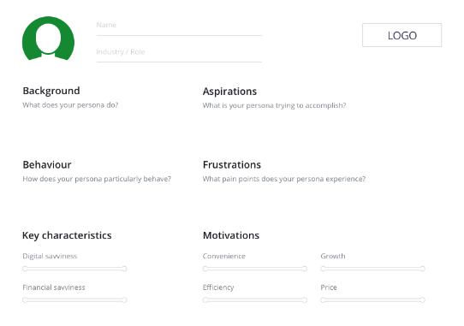
Building user personas helps product teams understand the user and their pain points
ILLUSTRATIVE
User personas are behavioural and psychographic profiles of target users or companies. These fictional user profiles (e.g. micro-budgeter, spontaneous spender) represent distinct user needs, values, pains, and motivations throughout the user lifecycle.
When to use this?
Option 1: Proto-persona developed amongst the team to identify the user and begin to empathise with them
Option 2: After interviewing the target user groups to create a real user profile
Tips:
Give your persona a name to bring it to life. Key characteristics and motivations can be amended based on your specific scenario.
Encourage people to individually write their thoughts on post-its at the beginning, then get everyone to put up their notes and discuss
Discovery Kickoff
Mapping Current State
ZBD Development
MVP Workshop
Validation

Slide 24
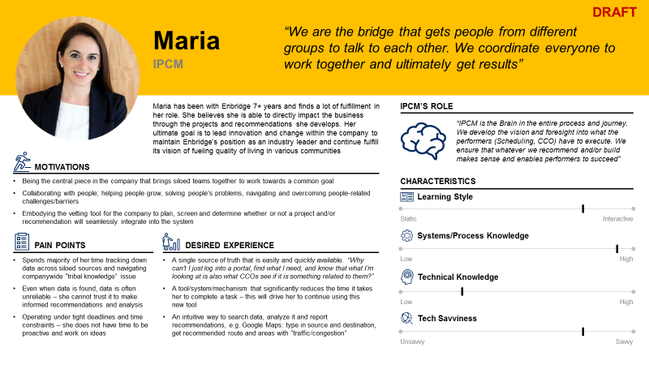
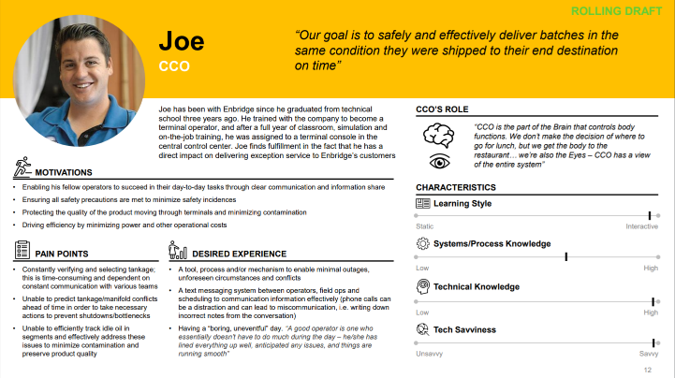
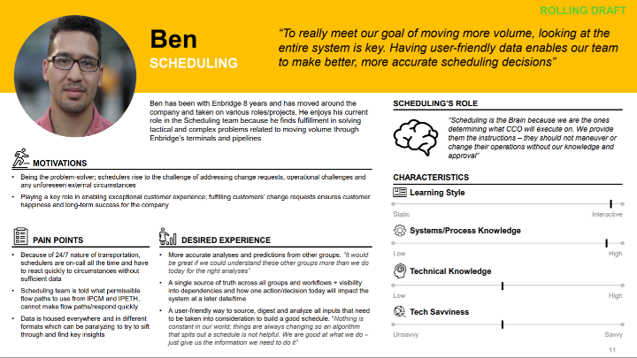
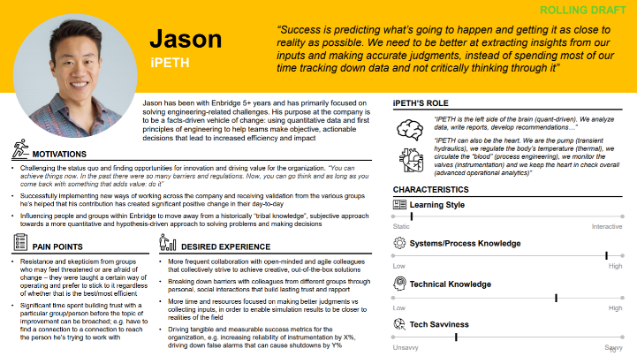
User Persona: Example from Terminal Utilization
EXAMPLE
Example of a developed digitised Persona’s
Discovery Kickoff
Mapping Current State
ZBD Development
MVP Workshop
Validation

Slide 25
Building empathy maps assume the perspective of their personas and design more meaningfully
Empathy mapping is a process to understand the whys of a user’s motivation for a particular solution to tasks. It takes your team from simply knowing your audience to understanding and identifying with them. Empathy mapping allows you to consider and examine your target user’s greatest motivations, desires and hurdles when it comes to your business or product, in turn, allowing you to make meaningful content and design decisions.
When to use this?
After user interviews and ideally in conjunction with a Persona exercise to get a deeper understanding of the emotional motivations of your Persona
Tips:
Build on your Empathy Map from your Persona. It creates alignment on user needs, goals, and pain points, and bridges the gap between an audience’s personas and the content you create.
Discovery Kickoff
Mapping Current State
ZBD Development
MVP Workshop
Validation

Slide 26
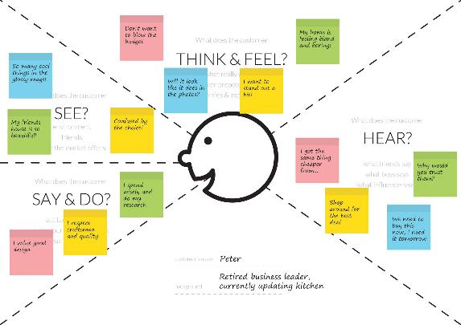
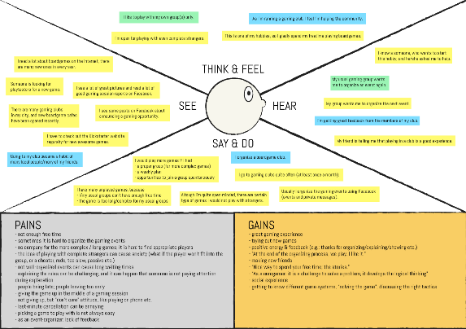
Empathy Map: Examples¹ Used for products with single user type
EXAMPLE
Discovery Kickoff
Mapping Current State
ZBD Development
MVP Workshop
Validation
1 No Terminal Optimization example due to multiple user base of TO product

Slide 27
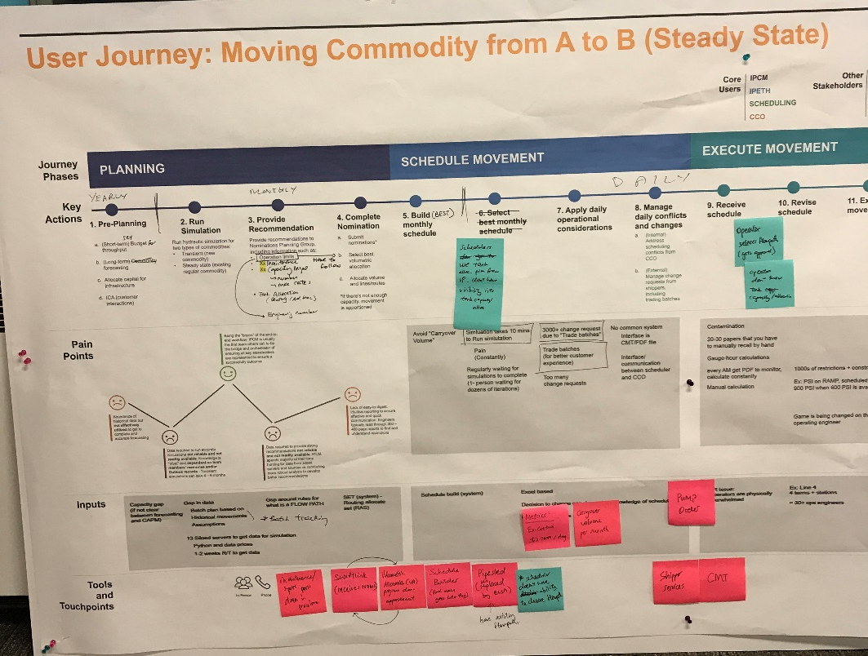
User Journey Maps are used to narrate the persona(s) interaction with the current state
ILLUSTRATIVE
Journey mapping narrates persona(s) interaction with a product/service. It focuses key events, pains and opportunities from each persona’s unique perspective. It highlights which user and issues your team is solving for.
Why use current state journey maps?
It provides a holistic view of quantitative and qualitative data
It forces emphasis on user experience
It creates a shared language around current user experience
It helps to identify opportunity areas and pain points (ideal state journey)
It focuses key events, pain points and opportunities from each persona’s unique perspective
Tips:
Keep your persona in mind as you are creating their current journey and really put yourself in the persona’s shoes – how are they feeling at each step? What questions and thoughts do they have?
Example User Journey: Terminal Optimization, January 2019
Discovery Kickoff
Mapping Current State
ZBD Development
MVP Workshop
Validation

Slide 28

Example user journey map: Terminal Optimization
TERMINAL OPTIMIZATION EXAMPLE
Typical Approach:
Identify the phases of the persona’s journey - keep it simple
For each phase, identify activity touchpoints the persona encounters (e.g., speaks to a person, visits a website, etc.)
Identify thoughts and emotions your persona would have during each phase of their journey. Plot these with an emoticon and explain (e.g., questions, thoughts, feelings)
Think about what your persona wants to accomplish at each phase of the journey
Discovery Kickoff
Mapping Current State
ZBD Development
MVP Workshop
Validation

Slide 29
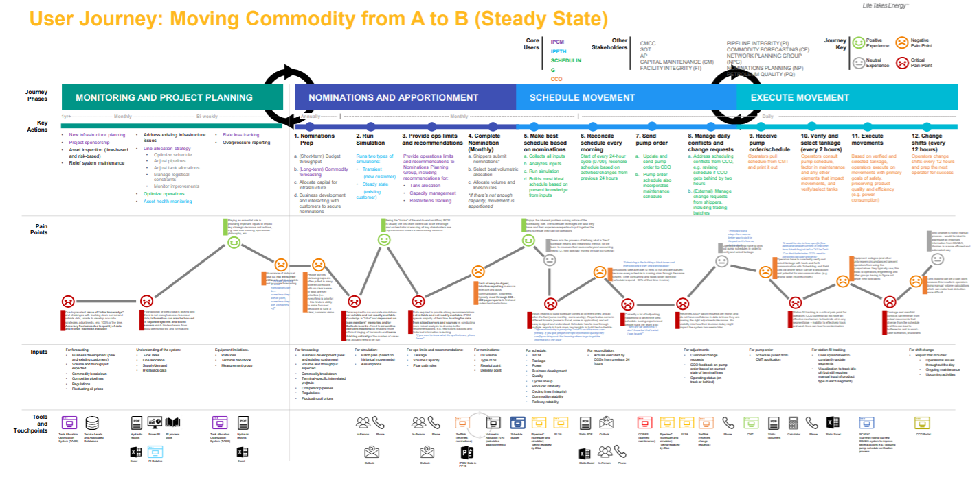
Example user journey map: Terminal Optimization
TERMINAL OPTIMIZATION EXAMPLE
Discovery Kickoff
Mapping Current State
ZBD Development
MVP Workshop
Validation

Slide 30
The product team should conduct a detailed technical impact assessment to help understand the current state
Overview of Mapping Current State for Technology
Before embarking on product design, the technical members of the product team (e.g., Architect, Data Engineers, Developers) need to understand the technical landscape on which they will build
The scope of the mapping should include both enterprise applications and non-functional requirements related to them, even if the product itself will not be incorporating them
Assessment requirements
Enterprise architecture
Ecosystem maps
Data flows with high-level data assessment
Current non-functional requirements
Discovery Kickoff
Mapping Current State
ZBD Development
MVP Workshop
Validation

Slide 31
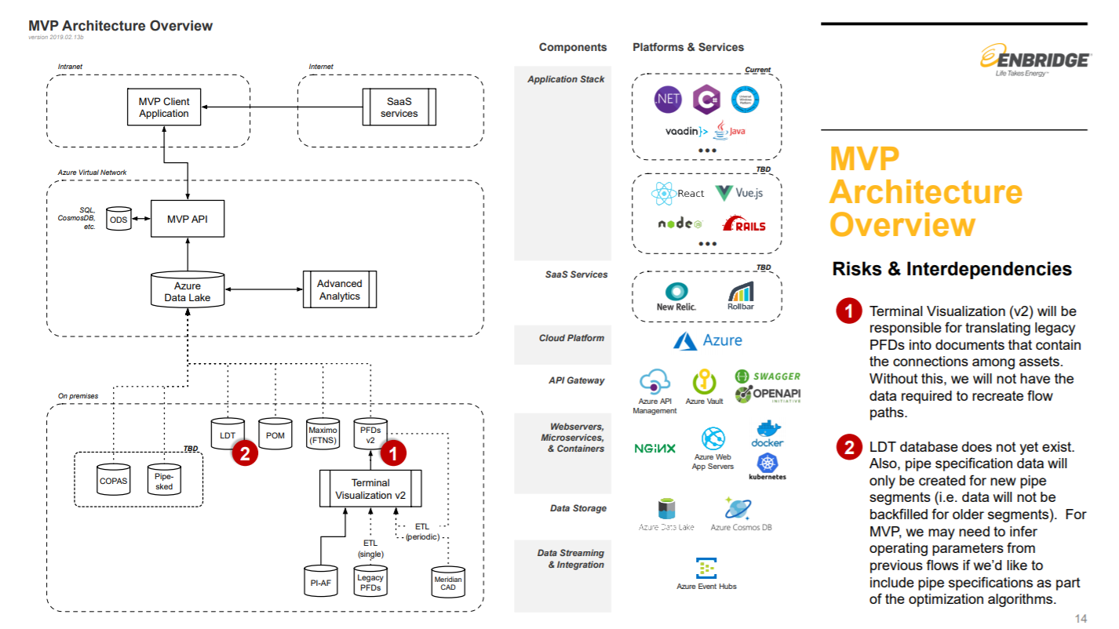
Example: Output technical impact assessment from Terminal Optimization
Discovery Kickoff
Mapping Current State
ZBD Development
MVP Workshop
Validation

Slide 32
The Zero-Based Design process applies blue-sky thinking to re-imagine an ideal user experience
2
Zero-Based Design
Build the ideal journey state from the user’s perspective
Identify the design features that enable this journey
1
Current state
Understand the existing user process and its “pain points”
Understand current technology and data landscape
3
Minimum Viable Product
Establish the MVP by:
Test zero-based state (e.g. ZBD output) in real-world and understand technical and implementation barriers and constraints
Identifying what is realistically achievable during sprinting
End-up with only what is absolutely necessary to deliver the stated outcome
Discovery Kickoff
Mapping Current State
ZBD Development
MVP Workshop
Validation

Slide 33
The ZBD process disregards current processes and limitations to develop an ideal-state user experience
ZBD Development designs an ideal user journey by…
Ignoring what is in place today; imagine this is for an imaginary new company
Focusing on creating “signature moments” rather than just fixing issues
Aspiring to create the best experience in the world, regardless of what our systems can or cannot do
Discovery Kickoff
Mapping Current State
ZBD Development
MVP Workshop
Validation

Slide 34
The ZBD Development takes place in two key iterative steps following design-thinking principles
ZBD Development process
Throughout ZBD Development, product team members should observe design-thinking principles to better empathize with their user and build more functional product designs – guidance follows
Starting from a clean slate, build the ideal journey state from the user’s perspective, adopting that of the persona built by the team
Identify the design features that enable this journey – what product or process features need to be in place for this ideal journey?
Discovery Kickoff
Mapping Current State
ZBD Development
MVP Workshop
Validation

Slide 35
Design thinking specifically involves observing certain principles to foster creativity and empathy
In doing Zero-Based Design work, agile teams should be…
IMAGINATIVE
EMPATHETIC
MULTI-DIMENSIONAL
ACTIONABLE
Design thinking is about solving problems through an indirect, lateral, and creative approach in a way that is not immediately obvious or comfortable
Human-centered design is our core philosophy, so listening to end users and observing them are critical to unearth their digital needs
Collaborating with business, technology, and design experts is the ideal A-team when going into product ideation, evaluation frameworks, and prioritization exercises
Design thinking needs to quickly lead to design concepts, user validation, and production
Discovery Kickoff
Mapping Current State
ZBD Development
MVP Workshop
Validation

Slide 36
Best practices for running ZBD Development sessions
Do…
Don’t …
Dive into the wishes and frustrations of the users, even if they are contentious
Plan on getting the wireframes in front of real users to validate your thinking – we’ll simulate this experience later in the afternoon!
Worry about technical complexity during ZBD; this is the time to dream big!
Feel the need to get all the details “right” in two days; in a real development setting, you will perfect the features in collaboration with real users
Discovery Kickoff
Mapping Current State
ZBD Development
MVP Workshop
Validation

Slide 37
The Minimum Viable Product focuses on the features that are most critical to delivering value from the ZBD
2
Zero-Based Design
Build the ideal journey state from the user’s perspective
Identify the design features that enable this journey
1
Current state
Understand the existing user process and its “pain points”
Understand current technology and data landscape
3
Minimum Viable Product
Establish the MVP by:
Test zero-based state (e.g. ZBD output) in real-world and understand technical and implementation barriers and constraints
Identifying what is realistically achievable during sprinting
End-up with only what is absolutely necessary to deliver the stated outcome
Discovery Kickoff
Mapping Current State
ZBD Development
MVP Workshop
Validation

Slide 38

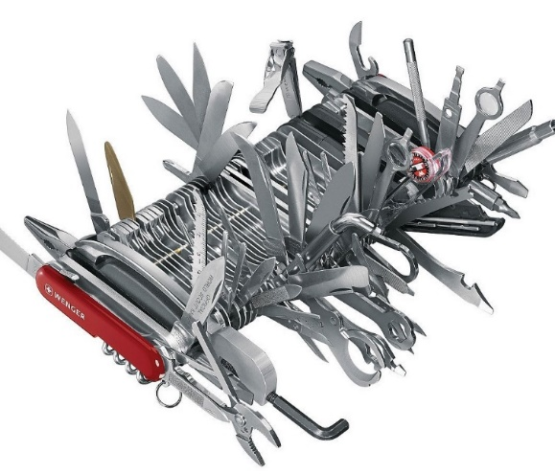
MVP moves away from making the perfect thing all at once to making a simple but great thing and then evolving
What is the MVP
Minimal: smallest thing you can build that delivers user value
Viable: has the core functionalities necessary to complete the job
Features included in a MVP should drive user adoption but be technically feasible
Basics
Everything
What the MVP is NOT
Released product that includes a range of functionalities that only partially work
A product that starts with the easiest functionality to build/improve
Nature of MVP
The MVP is always evolving based on:
New insights from stakeholders, advisors and the team
More in-depth technical analysis
Internal and external constraints
Discovery Kickoff
Mapping Current State
ZBD Development
MVP Workshop
Validation

Slide 39
MVP construction should begin with “signature moments” and then prioritize features based on value and feasibility
Prioritize signature moments
Align on value and prioritize features
Identify feasibility and define MVP
Determine open questions and next steps
MVP features should be chosen from the highest value but most feasible group in the 2x2 view
Goal
High
?
Technical feasibility
Med
From the user journey, identify 3-5 signature moments that should be prioritized
Prioritize features flowing from user journey on the basis of their value (High / Medium / Low)
Assess features for how feasible they are (H/M/L) and, using a 2x2, define the MVP feature set
Identify any open questions which may change the prioritization of the signature moments
Description
Low
Low
Med
High
Business Value
Discovery Kickoff
Mapping Current State
ZBD Development
MVP Workshop
Validation

Slide 40
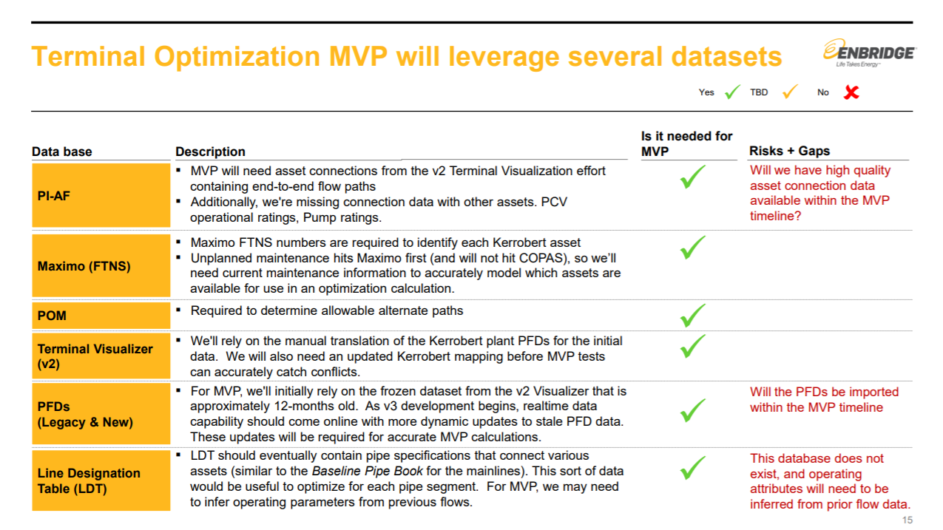
Example output: identifying MVP features for Terminal Optimization product
Discovery Kickoff
Mapping Current State
ZBD Development
MVP Workshop
Validation

Slide 41
The product team should build a technical view on how to support the MVP vision
Technical perspective on MVP design
Having defined the MVP design, the architect, Product Owner, and other SMEs should identify the underlying technology to enable that design
The perspective should be a forward-looking end-state view of the architecture once the product has reached a substantially complete state and has been deployed to the enterprise
An ecosystem view is helpful in bringing the architecture to life
Requirements
Forward-looking architecture with enterprise connection points
Recommended technology stack defined (e.g., architectural vision)
Conceptual data flows to enable MVP functionality
New non-functional requirements based on new user journey
Discovery Kickoff
Mapping Current State
ZBD Development
MVP Workshop
Validation

Slide 42
After aligning on an MVP, teams should validate its design, impact, and feasibility against product goals
Category
MVP validation
Design
Teams should put MVP designs through user testing to determine if the conceptual MVP will meet user needs
Business
Teams should build a detailed business case for the impact of their MVPs and then identify key KPIs with targets against which they can track products’ impacts
Technology
Teams should conduct a detailed technology impact assessment to determine what technology changes will be required to build and implement the MVP
Discovery Kickoff
Mapping Current State
ZBD Development
MVP Workshop
Validation

Slide 43
User testing ensures that an MVP design will meet its users needs
Category
Validation element
Design
User testing
Business
Detailed business case
Key KPIs with targets
Technology
Detailed technical impact assessment
Discovery Kickoff
Mapping Current State
ZBD Development
MVP Workshop
Validation

Slide 44
User testing allows teams to directly observe users interacting with a design to get real-time feedback
User testing involves getting your concept in front of future users to receive critical feedback early and fast
User testing does not need a working product. Concepts, wireframes, or mock-ups can effectively be tested with users for feedback
Objective
Test concepts and designs with users to determine if a concept or product designed in a sprint meets the needs and goals of users
Receive critical feedback early in the design process to allow teams to make adjustments without progressing too far
Benefits
Quickly validate the effectiveness of the product and proposed solution
Identify usability issues
Confirm the proper definition of the MVP and plan for after – are there any important features missing? Are there new questions to investigate following releases?
Output
Validate the usefulness of the product and define the MVP feature set
Provide inputs into the design of the product’s user interface
Product management may use observed interactions and script excerpts to inform user stories
Identify features or functionality that may not be useful
Discovery Kickoff
Mapping Current State
ZBD Development
MVP Workshop
Validation

Slide 45
Successful user testing requires testing multiple areas of the product with your user
Process Flow: Validate whether users can navigate the application as designed to accomplish the desired tasks without getting stuck or confused and how long it takes them
"Sticking Points": Uncover where in the application users get stuck and why users find certain screens to be not intuitive or difficult to navigate
Interaction Model: Validate whether the navigation mechanism that links all the screens together (menus, buttons, swipe-to-go-back, etc.) makes sense and learn where a different approach might be required
Process Copy: Does the text in the application give users the information and confidence they need to navigate the application without getting confused or "put off" by language
User Testing
User Delight: Do users like the product? Why? Are there parts the users don't care for? Why not? Given the alternatives, will users engage with the new process once it's in market?
Technical Capabilities: In later tests, when the back-end systems are integrated with the screen, user testing can help uncover whether the system is working as it should and at an acceptable speed
Discovery Kickoff
Mapping Current State
ZBD Development
MVP Workshop
Validation

Slide 46
Product teams should observe certain ground rules to get the maximum value out of user testing
Some ground rules to make sure empathy stays front and center
1
We are here to learn, not to sell. Have an open mind.
User testing is qualitative research and is not a survey. It is not meant to be objective or exhaustive – it is meant to provide inspiration and direction forward in the design process. It can provide color, context, some great questions to ask, and even sometimes some answers. The “secret sauce” of this kind of research is that it involves real people talking about their real lives. Accordingly, empathy is required.
2
This is about the user, not us. They drive the conversation, which means some questions might not get asked.
3
All questions should be filtered through the moderator, who will turn to us at prescribed times and ask if we have questions. Outside of those times, please stay silent.
4
There are no wrong answers here. Even things that don’t sound right can still be enlightening. Never correct the user.
5
Pay attention to everything. Often, it’s not what people say or do that is interesting, it’s what they don’t say or don’t do.
6
These users could be our product end users, so treat them with respect.
Discovery Kickoff
Mapping Current State
ZBD Development
MVP Workshop
Validation

Slide 47
Checklist for preparing to run a user-testing session
Define and select the key moments (or features) to test (from MVP Workshop)
Create sketches for the the key moments, storyboard concepts or define the user flows (from MVP Workshop)
Prototype the key moments based on the sketches and storyboarding activities (can be low-tech “prototypes”)
Recruit and schedule people for user testing
Establish a key set of questions to ask, and key A/B scenarios to test
Discovery activities
Select one or two moderator(s) to run the tests - two moderators allow you to run tests in parallel
Convene members of the sprint team to observe the test and take notes
Identify test subjects: These people are members of the product’s target user audience who are not part of the sprint team
People
When possible, use an interactive prototype
Write a user testing script to walk users through the scenario or flow that corresponds with the prototype
For remote testing set up a screen-sharing tool in advance
Project the test on a large monitor so all observers can view the subject’s shared screen
Materials
Discovery Kickoff
Mapping Current State
ZBD Development
MVP Workshop
Validation

Slide 48
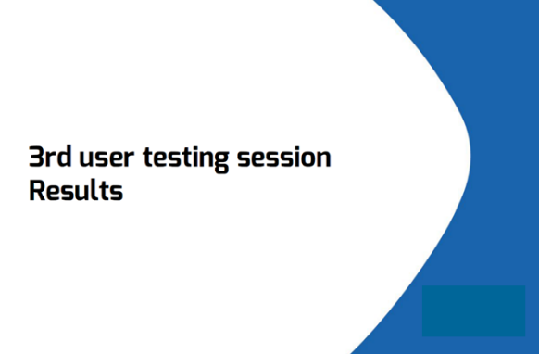
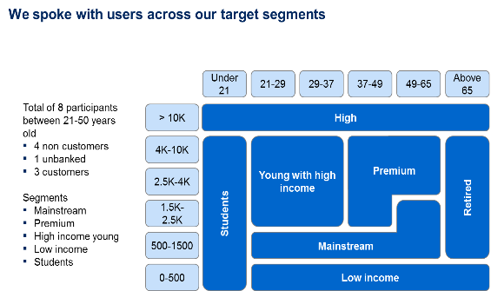
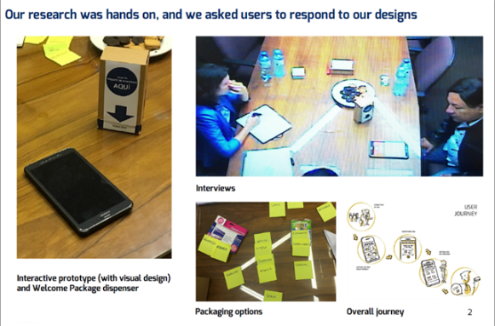
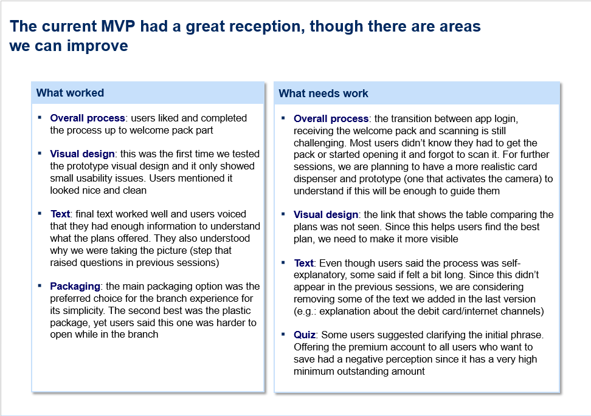
Following user testing, the Design team should synthesize their findings and share back with the team
Discovery Kickoff
Mapping Current State
ZBD Development
MVP Workshop
Validation

Slide 49
A detailed business case accompanied by targets aligned to trackable KPIs ensure business impact
Category
Validation element
Design
User testing
Business
Detailed business case
Key KPIs with targets
Technology
Detailed technical impact assessment
Discovery Kickoff
Mapping Current State
ZBD Development
MVP Workshop
Validation

Slide 50
After validating the MVP design, the team must build a detailed business case for review at PLC Review 2
Detail follows
Elements of the detailed business case
With an MVP design in hand, product teams must build a detailed business case for their new product design to validate that it can achieve some part of the value expected from the product path
As part of the business case, teams must identify key KPIs related to the product’s expected impact and set targets for the products performance against those KPIs
Product scope
Operational information
Product path description
Delineated scope
MVP features
Potential post-MVP features
Targeted user groups
Business sponsor
Go / no-go recommendation
Agile delivery strategy
Implementation strategy
MVP Delivery Plan
Sequencing and dependencies
Impact
Investment required
Business impact with analysis summary
Key KPIs
Impact targets against KPIs
Estimated costs for MVP development
Estimated level of effort (story points) for MVP development
Estimated time to impact
Discovery Kickoff
Mapping Current State
ZBD Development
MVP Workshop
Validation

Slide 51
The Product Owner should first set key “north star” KPIs for the MVP based on its expected impact
EXAMPLE – FINANCIAL / BANKING
Example KPIs
Example targets
Reach
Migration rate for new process:
Number of accounts opened through digital solution in-branch
% of accounts opened in-branch through digital solution (per branch level)
35% of total accounts opened in pilot branches will use our digital solution
Assume 50% migration from users (“low adoption” segments will have a 20% migration rate and “high adoption” segments will have an 80% migration rate)
Assumes that ~70% of account types are eligible (payroll account and Gold debit cards are out of scope for our MVP)
UX
Ease of use of digital solution:
In-branch: % of accounts opened with minimal support from the greeter
40% of digital openings completed independently
Assume “low adoption” segments will have a 0% completion rate with minimal assistance and “high adoption” segments will have an 70% completion rate with minimal assistance
Satisfaction with account opening experience:
% of satisfied users of digital solution (captured through question at end of process)
70% of users satisfied with the process
Current baseline for user satisfaction with branch experience while open-ing a savings account is ~60% (top two boxes) and ~5% (bottom 2 boxes)
Time for process:
Average time the account opening process takes (traditional versus digital)
10 min or less to open an account (depends on user testing results)
Current baseline is ~25 minutes including wait and service time
Discovery Kickoff
Mapping Current State
ZBD Development
MVP Workshop
Validation

Slide 52
A detailed technical impact assessment evaluates technical investment required to realize impact
Category
Validation element
Design
User testing
Business
Detailed business case
Key KPIs with targets
Technology
Detailed technical impact assessment
Discovery Kickoff
Mapping Current State
ZBD Development
MVP Workshop
Validation

Slide 53
The product team should conduct a detailed technical impact assessment to determine MVP feasibility and implications
Overview of technical impact assessment
Assessment requirements
The product team – led by the lead architect – should conduct a detailed technical impact assessment to determine what technical work would be required outside of the product team to make the product successful
Enterprise architecture groups should help shape the form of this impact assessment
Products with high technical impact based on their build design may face approval challenges with the Lab Executive Team at PLC Review 2 based on feasibility or investment concerns
Architecture changes required to support product deployment
Tech stack changes based product vision including highlighted technical debt created
Changes to existing data flows needed to support product functionality
Technical risks identified
Discovery Kickoff
Mapping Current State
ZBD Development
MVP Workshop
Validation

Slide 54
PLC Review 2 is the final stage prior to the commencement of product development
PLC Review 2 Process
Example Agenda:
Overview of product scope – (10 min)
Summary of Discovery output – (15 min)
Presentation of proposed MVP (20 min)
Refined KPIs with baseline (if available) and targets (10 min)
MVP sign-off (5 min)
Purpose
Stakeholders
Pre-Work
Tasks
Go / no go criteria
2
PLC Review
Ensure that product MVP will be impactful for the business
Provide executive guidance and input prior to sprinting
Determine if Discovery output is aligned with:
Business case
Company vision
Agile methodologies
Product Owner – responsible for presenting the idea and business case to the PLC
Lab Executive Team– responsible for approving the business case and accepting go / no go criteria
Successful passing of PLC 1
Completion of Discovery phase activities
Discovery Kickoff
Mapping current state
ZBD Development
MVP Workshop
Validation
Approve MVP concept
Approving KPIs set during Discovery
Preliminary risk identification and go-forward mitigation plan
Pressure-test MVP’s likelihood to deliver on the KPIs based on user insights and other data
Align on Lab logistics
Location
Team size
Start date / timeline
MVP capable of delivering on proposed value
MVP concept fits within the Lab principles
Funding secured
Business endorsement
Technical feasibility tested and validated
1 hour¹
After MVP sign-off, teams move onto Sprint 0 (e.g., team prep, backlog build, MVP delivery plan, MVP architecture) and then begin agile delivery work
1 Per product

Slide 55
Contents
Overview of the PLC process
Deep-dive on PLC stages and PLC Reviews
Ideate, Pre-Discovery, and PLC Review 1
Discovery and PLC Review 2
Sprint 0, MVP Build, and PLC Review 3
Scale and PLC Review 4
Tactical guidance for PLC Reviews

Slide 56
Team preparation focuses on rapidly enabling the team to start sprinting
Activity
Pre-Requisites
Mobilize the team: Ensure a common understanding of the process to be leveraged for the release
Owner: Product Owner (and Scrum Master if applicable)
Participants: Team, Product Owner
Team staffed with all required skills needed
Agile capabilities available to provide overview
Defining roles and responsibilities: Scrum collapses roles and responsibilities to drive shared ownership, responsibility and quality in every sprint
Owner: Product Owner (and Scrum Master if applicable)
Participants: Team and Product Owner
Introduction/training sessions for all participants
Well defined roles to support the team
Enough individuals with or working on acquiring required skill sets
Establish team cadence and working norms: Agreement on how the team will work together and sprint cadence
Owner: Product Owner (and Scrum Master if applicable)
Participants: Team and Product Owner
Team has shared space
Team and leadership agree to follow agile principles
Team collectively define working agreements
Environment setup: Have everything in place for the team to start development including environments and tools for every team member. One of the environment should be same as Production
Owner: Product Owner (and Scrum Master if applicable)
Participants: Team
Dev, E2E and QA environment, technology selection
Alignment on technology foundation for MVP : Building an understanding of tech spikes, data dependencies, constraints, architecture design, and data models
Owner: Solutions Architect (if applicable) or Product Owner
Participants: Team
Solutions Architect or similar onboarded to team
Dev, E2E and QA environment, technology selection

Slide 57
Teams build the backlogs for their product paths in Sprint 0 and translate them into an MVP delivery plan
With an MVP design and high-level features, product teams should use Sprint 0 to break the MVP design into a product path backlog comprised of epics and stories, with the MVP set aligned to sprints as part of an MVP Delivery Plan
Product Path Backlog
MVP Delivery Plan (aligned to sprints)
Epic
Epic
Epic
Story
Story
Story
Story
Story
Story
Story
Story
Story
Story
Story
Story
Story
Story
Story
Story
Story
Story

Slide 58

The product backlog is a living, evolving artifact that is managed by the Product Owner and built during Sprint 0
High
Priority
Each iteration implement the highest- priority work items
While sprinting, each new user story is prioritized and added to the stack
Modeled in greater detail
A product backlog is comprised of user stories describing elements of functionality that will be incorporated into a product
User story may be reprioritized at any time
Modeled in lesser detail
User story may be removed at any time
Stories are a
User’s need
Product description
Planning item
Token for a conversation
Mechanism for deferring conversation
Low
Priority
User stories

Slide 59

User stories are functionalities written from the perspective of end users of the solution
What is a user story?
A light weight technique for communicating requirements
Shift the focus from writing about requirements to talking about them
Encourage 2-way communication
User Stories are "a promise of a conversation"
Simple focused format
a short, simple and concise way to describe functionality that is valuable to a user
can be written on an index card
Who, What, Why…
Written from the perspective of a user
there can be several types of user/personas (public user, Admin, active user, API User etc…)

Slide 60
User stories need to contain acceptance criteria that define the functionality in greater detail
For the Product Owner
For the Developer
They are a much finer grained requirements definition than the Story
Focuses the team on how a feature will work from the user’s perspective
It removes ambiguity from requirements
They help form the basis of functional test cases
They can be supported by other information like screenshots or UI wireframes, design documents, or anything that provides more detail about what should be implemented
They assist the developers and testers when estimating the Story
It forms the tests that will confirm that a feature is working and complete
It limits the developers to adding only the functionality that the user story requires
Acceptance Criteria for a User Story are the conditions that the story must fulfill to be considered “Done”. It focuses on external quality and functionality. These conditions are provided by the business and must be one of the parameters in your “Definition of Done” list

Slide 61
With a complete user story backlog, the team should create a MVP delivery plan that will evolve over time
Deep dive follows
Agree on key definitions
Estimate effort required
Estimate team velocity
Identify risks & interdependencies
Plan MVP delivery
Team agrees on Definition of Done and Ready for Work
Scrum team estimates story size
Team identifies stories for sprint 1 and future sprints based on an assumed capacity
Team extrapolates the assumed velocity (number of story points per sprint that a product team can accomplish) for the number of sprints in the release based on estimated capacity
While sizing stories team identifies assumptions, risks and potential solutions
MVP delivery planning results in a product roadmap with preliminary sprint schedule for the team. Team should align on the MVP vision and objectives.

Slide 62
As part of delivery planning, teams need to agree to Definition of Ready and Definition of Done
Description
Examples
Definition of Ready
A Definition of Ready ensures that everyone knows when a story is ready to be taken into a sprint, or when all necessary conditions are right for a team to start a sprint
Story defined and written
Acceptance criteria generally agreed
Dependencies identified
Story sized by the development team
Performance criteria identified
Team has a good idea on how to demo the story
Definition of Done
A Definition of Done ensures that working software produced at the end of the sprint is of high quality and potentially shippable
Teams typically start with a simple definition of done and slowly evolve over time as they have a stable sustained velocity
Code is reviewed and all tests passed
Code approved by Product Owner
All acceptance criteria are met
Required documents updated
Unit test coverage is 90%
No high or critical defects identified in the backlog
Performance test accepted and signed off
Regression testing complete

Slide 63








In planning, teams use relative sizing to evaluate effort required for user stories and MVP deployment
Teams use t-shirt sizes to estimate effort using story points…
…and then roll all story needs into total backlog effort
SM story = 1 point
Story points are the team’s estimation of a user story’s relative size and complexity
Story points allow for easy follow-up on story completion and effort estimation
SM, MED and LG stories should be achievable within a single sprint
XL stories typically form epics and should be broken up into multiple user stories – detail follows
MED story = 3 points
LG story = 8 points
20 SM X 1 pts
17 MED X 3 pts
14 LG X 8 pts
13 X-L X 13 pts
XL story = 13 points
Backlog 352 pts

Slide 64
MVP delivery planning results in a product roadmap with preliminary sprint schedule for the team
ILLUSTRATIVE
High - Business Value - Low
Sprint 1(estimated velocity=10)
Sprint 2 (estimated velocity=10)
Sprint 3…
Sprint 4
Story xx
Story xx
Story xx
Story xx
Story xx
Story xx
Story xx
Story xx
Story xx
Story xx
Story xx
…
Low - Story Priority - High
Story xx
Story xx
Note that the MVP Delivery Plan will evolve over time as the team improves at estimating effort and understanding team velocity

Slide 65
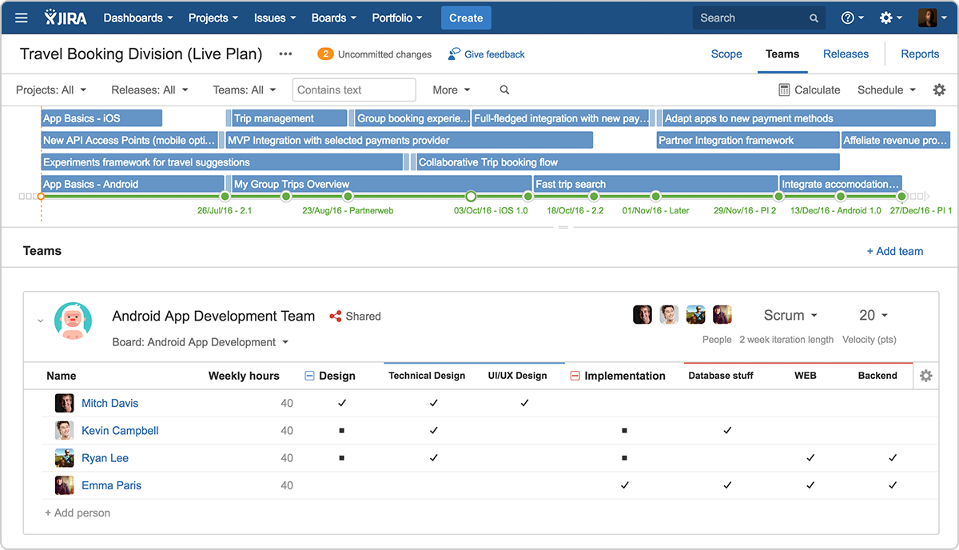
Example: MVP delivery planning using Jira
EXAMPLE
SOURCE: Atlassian https://www.atlassian.com/

Slide 66
After Sprint 0, teams embark on MVP build following the Lab’s product team operating model
Please refer to the “Product team operating model” chapter of the T+IL Playbook for guidance on product team operations within MVP Build and beyond

Slide 67
PLC Review 3 approves the MVP and reviews/approves the feature sets for deployment in Scale phase
PRELIMINARY
PLC Review 3 Process
Example Agenda:
Overview of product roadmap (5 min)
Summary of MVP output (20 min)
Presentation of proposed deployment feature set (20 min)
Refined KPIs with baseline (if available) and targets (10 min)
Sign-off of Scale (5 min)
Purpose
Stakeholders
Pre-Work
Tasks
Go / no go criteria
3
PLC Review
Determine if MVP output & product roadmap is aligned with:
Company vision
Agile methodologies
Features committed in PLC Review 2
Ensure that significant value exists to push the product into Scale
Approve first deployment feature set of Scale
Provide executive guidance and input on further product development
Product Owner – responsible for presenting the MVP and next deployment feature set to the LET
Lab Executive Team – responsible for approving the business case for Scale and accepting go / no go criteria
Completion of MVP phase activities
Deployed product at the hands of users
Value tracking in place
Presentation of MVP with identified proof points
Feature set for first deployment of Scale (created at end of MVP stage in 1-week Sprint 0)
Refined business case & value drivers for further features tied to P&L
KPIs / metrics impacted
Approve MVP output and shift to Scale
Review product roadmap and approve deployment features set for Scale
Approve KPIs for Scale deployment
Risk identification from MVP phase and go-forward mitigation plan
Align on Lab logistics
Team structure
Deployment timeframe
Funding
MVP capable of delivering on proposed value
Scale deployment fits within the Lab principles (incl. strong business case)
Funding sourced & secured
Business endorsement
Technical feasibility tested and validated
1 hour
After PLC 3, teams move into Scale where the product is enhanced through the deployment of further features and/or rolled out to the further business areas of Enbridge

Slide 68
Contents
Overview of the PLC process
Deep-dive on PLC stages and PLC Reviews
Ideate, Pre-Discovery, and PLC Review 1
Discovery and PLC Review 2
Sprint 0, MVP Build, and PLC Review 3
Scale and PLC Review 4
Tactical guidance for PLC Reviews

Slide 69
PLC Review 4 determines if the majority of feature-building is complete and if the product should be moved to Sustain or continue in Scale
PRELIMINARY
PLC Review 4 Process
Example Agenda:
Overview of product roadmap, summary of deployed features & value captured (10 min)
Presentation of proposed path forward (10 min)
Refined KPIs with baseline for next phase (5 min)
Path forward sign-off (5 min)
Purpose
Stakeholders
Pre-Work
Tasks
Go / no go criteria
4
PLC Review
Determine if further building is required to capture value and achieve a substantially complete feature set
If not, determine if shift to Sustain is aligned with:
Business case
Company vision
Align on ownership of Sustain (if applicable)
Product Owner – responsible for presenting path forward and business case to the LET
Lab Executive Team – responsible for approving the business case and accepting go / no go criteria
TIS Business Partners– Responsible for managing ownership of product in sustainment phase
Completion of Scale phase with PLC Review 3 features deployed to organization
Demonstration of user uptake for latest deployment with value proof points
Summary of potential features that could be built out and estimated business impact of further development
Identify sources of value in P&L and establish targets for next phase
Approve completion of Scale phase
Review business impact of existing product
Approve sustainment KPIs
Review plan for product leaving the Lab and assignment of TIS Business Partner to own Sustainment
Demonstrable value from existing product features / roll-out
Compelling proof points for value from product
Strong business case for subsequent deployment feature sets (if looping in Scale)
TIS BP ownership and funding sources for Sustain (if shifting to Sustain)
Business endorsement
30 mins¹
After reviewing the product features and roadmap, the product either enters back into Scale phase to build out more features and capture further value OR it exits that Lab and enters into the Sustainment phase with the TIS BP’s

Slide 70
Contents
Overview of the PLC process
Deep-dive on PLC stages and PLC Reviews
Tactical guidance for PLC Reviews
PLC Review presentation format
Quick reference for PLC Reviews
LET decision-making outlines for PLC Reviews

Slide 71
Contents
Overview of the PLC process
Deep-dive on PLC stages and PLC Reviews
Tactical guidance for PLC Reviews
PLC Review presentation format
Quick reference for PLC Reviews
LET decision-making outlines for PLC Reviews

Slide 72




Each PLC Review will follow the same high-level format tailored to the needs of each stage
Product
[A discussion of the product vision based on the requirements of the given PLC Review, with a clear statement of what the product(s) can be and what that will mean for users]
Impact
[A quick description of the business case and (as applicable) KPIs, with detail depending on the PLC Review stage]
Fit
[A concise statement of why the next phase of work is suited to work in the Lab, both from a product perspective – e.g., does it involve advanced technologies– and a process perspective – e.g., should it be done using Lab’s agile processes]
Feasibility
[A description of technical feasibility for the next phase of work, particularly relative to the Lab’s timeframes – e.g., 2-4 weeks for Discovery, 10-12 weeks for MVP build]
This overview page will structure each document, with each element being supported by 1-3 pages that will vary by product team for effectiveness

Slide 73
EXAMPLE: We recommend moving forward with Pipeline Integrity to the MVP Build phase in the T+IL
The lead of the summary page should always contain the team’s recommendation
PIPELINE INTEGRITY PLC REVIEW 2 EXAMPLE
Product
A user platform that helps operators better identify integrity issues faster solves a pressing business problem in GTM
Impact
The product as designed will lead to significant impact against safety and operational reliability goals
The summary page should give quick but compelling confirmation of what is needed at each PLC Review – supporting page(s) will provide detail
Fit
The product will be end-user-facing and is suited to cross-functional development in an agile environment like the Lab
Feasibility
While some work will be required on data architecture, the MVP can be built in 12 weeks (six 2-week sprints)
These dimensions should remain the same for each Review, including formatting for easy processing

Slide 74
Contents
Overview of the PLC process
Deep-dive on PLC stages and PLC Reviews
Tactical guidance for PLC Reviews
PLC Review presentation format
Quick reference for PLC Reviews
LET decision-making outlines for PLC Reviews

Slide 75
After Pre-Discovery, PLC Review 1 determines if an idea has the value and feasibility to move on to Discovery
PLC Review 1 Process
Example Agenda:
Overview of product idea – (10 min)
Business case presentation – (10 min)
Q&A (5 min)
Business case approval and PO assignment (5 min)
Purpose
Stakeholders
Pre-work
Tasks
Go / no-go criteria
1
PLC Review
Determine if the idea is feasible and impactful enough to move forward
Provide executive guidance and steering on idea
Idea Owner – responsible for presenting the idea
Lab Executive Team – responsible for approving the business case and qualifying criteria for go / no-go have been met
Idea concept / visual mockup with business sponsor
High-level business case (with high-level tech impact assessment)
Go-forward plan for Discovery phase
Proposed PO
Discovery workplan
List of required resources (stakeholders, space, etc.)
Approval of business case and necessary go / no-go criteria
Assignment of product owner and other key resources to team
Funding secured to proceed with Discovery
Business sponsorship and support plan
Significant business impact with trackable KPIs
Aligned to agile principles
Aligned to Lab digital strategy and existing product pathways
30 min¹
If a product idea does not successfully pass through the first PLC Review, it may:
Be sent to do further Pre-Discovery work before a second attempt
Be paused for a period of time until sufficient supporting work is done (e.g., data collection)
Be asked to combine with another idea to create a combined product idea
1 Per product

Slide 76
PLC Review 2 is the final stage prior to the commencement of product development
PLC Review 2 Process
Example Agenda:
Overview of product scope – (10 min)
Summary of Discovery output – (15 min)
Presentation of proposed MVP (20 min)
Refined KPIs with baseline (if available) and targets (10 min)
MVP sign-off (5 min)
Purpose
Stakeholders
Pre-Work
Tasks
Go / no go criteria
2
PLC Review
Ensure that product MVP will be impactful for the business
Provide executive guidance and input prior to sprinting
Determine if Discovery output is aligned with:
Business case
Company vision
Agile methodologies
Product Owner – responsible for presenting the idea and business case to the PLC
Lab Executive Team– responsible for approving the business case and accepting go / no go criteria
Successful passing of PLC 1
Completion of Discovery phase activities
Discovery Kickoff
Mapping current state
ZBD Development
MVP Workshop
Validation
Approve MVP concept
Approving KPIs set during Discovery
Preliminary risk identification and go-forward mitigation plan
Pressure-test MVP’s likelihood to deliver on the KPIs based on user insights and other data
Align on Lab logistics
Location
Team size
Start date / timeline
MVP capable of delivering on proposed value
MVP concept fits within the Lab principles
Funding secured
Business endorsement
Technical feasibility tested and validated
1 hour¹
After MVP sign-off, teams move onto Sprint 0 (e.g., team prep, backlog build, MVP delivery plan, MVP architecture) and then begin agile delivery work
1 Per product

Slide 77
PLC Review 3 approves the MVP and reviews/approves the feature sets for deployment in Scale phase
PRELIMINARY
PLC Review 3 Process
Example Agenda:
Overview of product roadmap (5 min)
Summary of MVP output (20 min)
Presentation of proposed deployment feature set (20 min)
Refined KPIs with baseline (if available) and targets (10 min)
Sign-off of Scale (5 min)
Purpose
Stakeholders
Pre-Work
Tasks
Go / no go criteria
3
PLC Review
Determine if MVP output & product roadmap is aligned with:
Company vision
Agile methodologies
Features committed in PLC Review 2
Ensure that significant value exists to push the product into Scale
Approve first deployment feature set of Scale
Provide executive guidance and input on further product development
Product Owner – responsible for presenting the MVP and next deployment feature set to the LET
Lab Executive Team – responsible for approving the business case for Scale and accepting go / no go criteria
Completion of MVP phase activities
Deployed product at the hands of users
Value tracking in place
Presentation of MVP with identified proof points
Feature set for first deployment of Scale (created at end of MVP stage in 1-week Sprint 0)
Refined business case & value drivers for further features tied to P&L
KPIs / metrics impacted
Approve MVP output and shift to Scale
Review product roadmap and approve deployment features set for Scale
Approve KPIs for Scale deployment
Risk identification from MVP phase and go-forward mitigation plan
Align on Lab logistics
Team structure
Deployment timeframe
Funding
MVP capable of delivering on proposed value
Scale deployment fits within the Lab principles (incl. strong business case)
Funding sourced & secured
Business endorsement
Technical feasibility tested and validated
1 hour
After PLC 3, teams move into Scale where the product is enhanced through the deployment of further features and/or rolled out to the further business areas of Enbridge

Slide 78
PLC Review 4 determines if the majority of feature-building is complete and if the product should be moved to Sustain or continue in Scale
PRELIMINARY
PLC Review 4 Process
Example Agenda:
Overview of product roadmap, summary of deployed features & value captured (10 min)
Presentation of proposed path forward (10 min)
Refined KPIs with baseline for next phase (5 min)
Path forward sign-off (5 min)
Purpose
Stakeholders
Pre-Work
Tasks
Go / no go criteria
4
PLC Review
Determine if further building is required to capture value and achieve a substantially complete feature set
If not, determine if shift to Sustain is aligned with:
Business case
Company vision
Align on ownership of Sustain (if applicable)
Product Owner – responsible for presenting path forward and business case to the LET
Lab Executive Team – responsible for approving the business case and accepting go / no go criteria
TIS Business Partners– Responsible for managing ownership of product in sustainment phase
Completion of Scale phase with PLC Review 3 features deployed to organization
Demonstration of user uptake for latest deployment with value proof points
Summary of potential features that could be built out and estimated business impact of further development
Identify sources of value in P&L and establish targets for next phase
Approve completion of Scale phase
Review business impact of existing product
Approve sustainment KPIs
Review plan for product leaving the Lab and assignment of TIS Business Partner to own Sustainment
Demonstrable value from existing product features / roll-out
Compelling proof points for value from product
Strong business case for subsequent deployment feature sets (if looping in Scale)
TIS BP ownership and funding sources for Sustain (if shifting to Sustain)
Business endorsement
30 mins¹
After reviewing the product features and roadmap, the product either enters back into Scale phase to build out more features and capture further value OR it exits that Lab and enters into the Sustainment phase with the TIS BP’s

Slide 79
Contents
Overview of the PLC process
Deep-dive on PLC stages and PLC Reviews
Tactical guidance for PLC Reviews
PLC Review presentation format
Quick reference for PLC Reviews
LET decision-making outlines for PLC Reviews

Slide 80
PLC Review 1 – look for a high-level vision with basic impact, fit, and feasibility assessments in support
Context: Idea Owners coming to PLC Review 1 will be looking to join the Lab and access resources for Discovery phase to identify an MVP product to build in a business area ripe for disruption
Product
Potential product teams hoping to join the Lab should describe the product path, or business area, to be disrupted by a number of potential products, with one or two examples of those potential products brought to life
Impact
The business impact description here should include high-level financial and/or operational impact of all the disruption we could see over the course of several products (not just the first one) for the business, with high-level KPIs identified
Fit
The fit focus for PLC Review 1 should be on whether disrupting this general business area in the way discussed will likely involve advanced technologies and will likely require cross-functional work with the business integrated into teams
Feasibility
The feasibility discussion should focus on whether the tech stack in this area will support disruption of some kind, with exact architecture TBD in Discovery phase

Slide 81
PLC Review 2 – look for a detailed MVP vision with clear impact tied to its design with demonstrable feasibility
Context: Product Owners coming to PLC Review 2 will be looking for the go-ahead to build a Minimum Viable Product (MVP) generated in Discovery phase using design thinking and integrating potential user input
Product
Product teams must clearly describe what the MVP will be, how users will use it, and what that will mean for how Enbridge does business relative to today – teams should really aim to bring these ideas to life in compelling and creative ways
Impact
Business impact for MVP should be more detailed and limited in scope than it was for the product path at PLC Review 1 and be clearly tied to the operational change the well-designed MVP will create, with more-detailed KPIs accompanying it
Fit
Teams should confirm at PLC Review 2 that the product will be a use case for advanced technologies and that the team required to deliver it will be cross-functional and commits to follow Lab processes
Feasibility
Teams must demonstrate that the tech stack and business area are both capable of supporting the build and roll-out of the specific MVP to be built

Slide 82
PLC Review 3 – look for an endorsed and functional MVP with a follow-on deployment that adds significant value
Context: Teams come to PLC Review 3 having built a functioning MVP to determine whether further build-out of the product in the Scale phase is in line with Lab strategy and processes
Product
Product teams must demonstrate two things for the product at PLC Review 3:
The business has committed to adopting a functioning MVP and sees its value – this should include a live demo of the product
What the next deployment will be from a product vision standpoint
Impact
For impact, teams must bring two things to PLC Review 3:
MVP business impact goals aligned to roll-out plan, with accompanying KPIs
Business impact for the next deployment tied to its specific functionality for users
Fit
Teams should confirm that its team structure and operating model for MVP have reflected the Lab’s processes, recommit to Lab operating model moving forward in development, and communicate the go-forward team structure
Feasibility
Teams must confirm that the next deployment of the product is also feasible in Lab timeframes and can be accommodated by the business

Slide 83
PLC Review 4 – be on the lookout for substantially complete feature set or exhausted business value
Context: Teams come to PLC Review 4 to make a case for further scaling of the product (cycling back to Scale phase) tied to business value or recommend a shift to Sustain if business value is exhausted
Product
Product teams must demonstrate three things for the product at PLC Review 4:
The business has adopted the deployed product
The business has confirmed value in latest deployment and committed to adoption
What the next deployment will be from a product vision standpoint
Impact
For impact, teams must bring two things to PLC Review 4:
The business is seeing actual value from the deployed product against KPIs
Latest deployment’s impact goals aligned to roll-out plan with syndicated KPIs
Business impact for the next deployment tied to its specific functionality for users
Fit
Teams should state whether the continued development for the product requires advanced technology and/or the Lab’s processes and environment – and if recommending a shift to Sustain, teams should recommit to Lab op model
Feasibility
Teams must confirm that the next deployment is also feasible in Lab timeframes and can be accommodated by the business (if recommending another deployment)

Slide 84
In each PLC Review, the LET can reach a few different decisions based on what teams demonstrate
ILLUSTRATIVE
Potential LET responses with examples of supporting observations
No – idea should not move forward
Maybe – idea needs further work
Yes – idea should move forward
PLC Review 1
Product path is not well positioned from business perspective
The concept sounds like TIS work
Impact is too low
Product path lacks clear definition but sounds promising
Impact is there but feels incomplete or unclear
Product path scope is clear
Disruption opportunity is clear
Impact is clear and feels complete, albeit at a high level
PLC Review 2
Users clarified that business not ready for disruption
Tech assessment identified major blockers in feasibility
Exact MVP scope is not clear
MVP scope does not seem feasible
Impact lacks detail or completeness
No commitment to Lab op model
MVP is clear as to what it will be and do for users
Scope seems feasible
Impact is significant and real
PLC Review 3
User testing of MVP yielded extremely weak results
Business does not commit to implementation
Minimal value in further dev work
MVP not deployment ready
Next deployment scope unclear
Impact lacks detail or completeness
No commitment to Lab op model
Looming technical debt
MVP is deployed and user testing has validated its usefulness
Business has committed to ops changes to integrate MVP
Impact tracking is in place for MVP
Next deployment scope is clear, impactful, and feasible
PLC Review 4
Business value has been exhausted
Value from MVP or subsequent deployments has not been realized
Impact lacks detail or completeness
Impact tracking of previous deployments has slowed
User issues with previous deployments that require attention
Impact in further development is significant
Business is advocating for value in further development
Impact of previous deployments is clearly tracked and showing significant returns

